Slide 1
Software product management
Product process: Identify opportunity
Joydeep Barman

Slide 2
Contents
Overview of product process
Identifying opportunity
Product Strategy

Slide 3
Overview of product process
Identify opportunity
Assess the opportunity
Create business plan
Specify product features
Specify Minimum Viable Product (MVP) feature set
Test your MVP
Iterate & Pivot to improve product-market fit

Slide 4
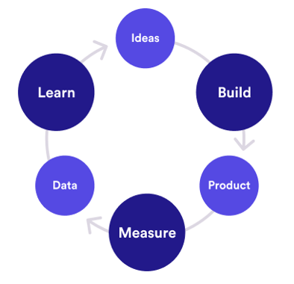

Build-Measure-Learn cycle
Customer interviews
Root cause analysis
Agile
Continuous integration
Minimize total time through the loop
# Visits, conversion, retention
How many use new feature?

Slide 5
Identify opportunity
Identify underserved customer needs (LPP)
Sources of innovation (Peter Drucker)
Hack days (Inspired)
Ideation techniques (Cooper & Edgett) (SPM book)

Slide 6
Identifying underserved needs
Observe
Experience
Fortune at the bottom of the Pyramid – CK Prahlad
Desire to do social good can find new opportunities

Slide 7
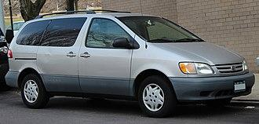
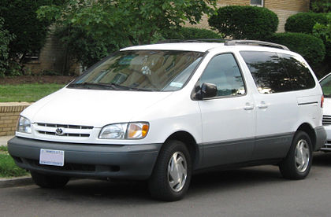
Observe
Toyota Sienna
  The car was successful in Japan
  Toyota wanted to understand the specific needs of US market
  A senior manager spent several months driving 70,000 miles across length & breadth of US observing how people use cars
  In US children sit in the backside of the mini van
  So changes were made to make the back seats more comfortable, safe, etc.
  When it was launched the car became a big hit

Slide 8
Observe
Oyo: Economy hotels were not clean, lacked basic amenities, etc.
Sketch: Observed that Photoshop was not easy to use
Slack: Collaboration between teams was clumsy
Spotify: People wanted to listen to music legally when illegal music sharing sites were banned

Slide 9
Experience
Ola cabs: Founder was travelling in a cab and cab driver demanded exorbitant amount to change the destination
DropBox: Founder kept forgetting to carry files in pen drive
Tally: Experienced that existing accounting packages had a User interface that catered to accounts / finance professional. But not to non-finance folks

Slide 10
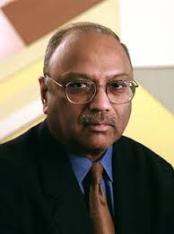

Opportunities are in plenty at the bottom of the Pyramid
Opportunities are aplenty if looked at the right market
CK Prahlad wrote a book ‘Fortune at the bottom of the Pyramid’
Large business tend to target the middle class and upper middle class
However there is a huge market at the bottom of the pyramid of society
They need products but can not afford high price
If the products are priced right, there is a big opportunity
Examples:
  Shampoo sachet for Re.1
  Micro credits to rural people to buy a sewing machine, a cow to start milk business, etc. It was observed that default by rural people is significantly less compared to urban people because of the fear of ostracism
  Jio, Nirma are other examples of targeting the bottom of the pyramid

Slide 11

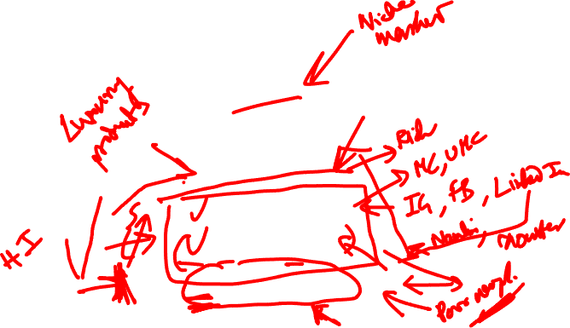
Maslow’s Hierarchy of Needs (Bonus content)

Slide 12
Desire to do social good can find new opportunities
(Social entrepreneurship)
Grameen Bank: Mohammad Yunus helped poor to stand on their own legs through micro-businesses
Aravind Eye Hospitals: Free eye surgery for poor, funded by rich patients, developing low cost intraocular lenses
Narayana Hrudalaya: Dr Devi Shetty offeres low-priced heart surgeries by employing efficient operation procedures, low cost insurance schemes
Selco: Dr. Harish Hande developed solar lamps to helps silk farmers harvest mulberry leaves which needs to be done during cooler hours – late evening or early morining
Rivigo: Helped truck drivers lead a stigma free life through relay based truck logistics
Apna: Developed an app for finding blue collar jobs such as delivery boys

Slide 13
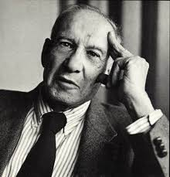
Sources of Innovation: Peter Drucker
Father of management
&
A Social scientist
https://hbr.org/2002/08/the-discipline-of-innovation

Slide 14
Sources of Innovation: Peter Drucker
Drucker argues that most innovative business ideas come from methodically analyzing seven areas of opportunity
Some of which lie within particular companies or industries
Some of which lie in broader social or demographic trends.
Astute managers will ensure that their organizations maintain a clear focus on all seven

Slide 15
Sources of innovation: Peter Drucker
Unexpected occurrence
Incongruities (incompatibilities)
Process needs
Industry & market changes
Demographic changes
Change in perception
New knowledge

Slide 16
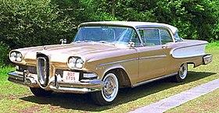
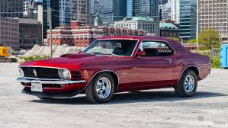

Sources of innovation: Peter Drucker
Unexpected occurrence
  IBM developed accounting machines in 1930s. Banks did not have money to buy. But libraries had money and they bought 100 machines
  Ford Edsel was very carefully designed. But people bought cars for lifestyle. This resulted in newer models like Mustang

Slide 17
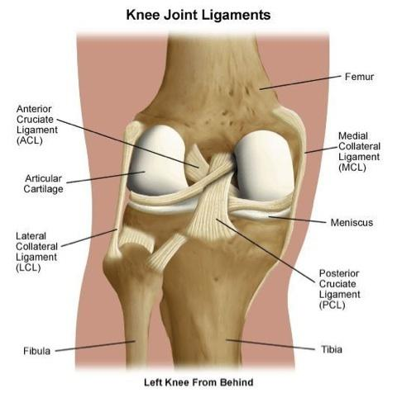
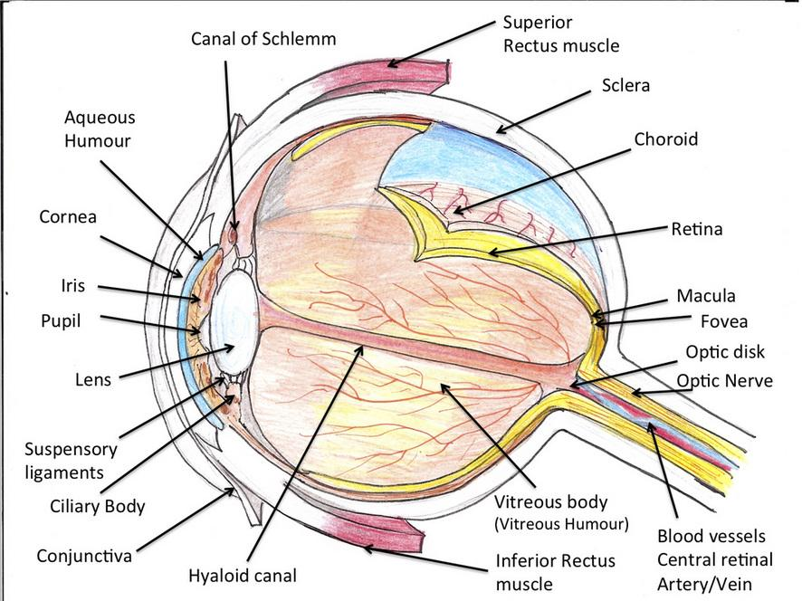
Sources of innovation: Peter Drucker
Incongruities (incompatibilities)
  Cataract operation: Cutting eye ligament is difficult. Instead used enzyme to dissolve ligament

Slide 18
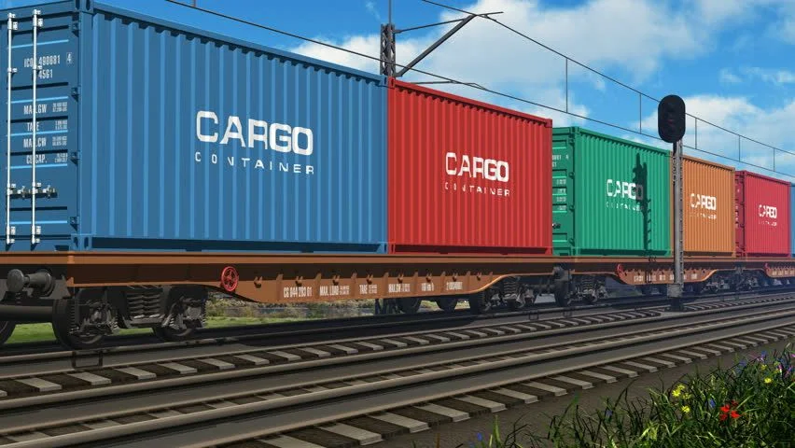
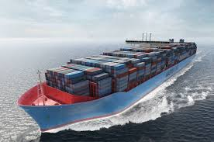
Sources of innovation: Peter Drucker
Incongruities (incompatibilities)
  Shipping industry trying to improve speed and fuel efficiency. But problem was time wasted at ports to load & unload. Adopted containers used in railroad and trucks

Slide 19
Sources of innovation: Peter Drucker
Process needs
  Newspapers needed a faster way to print. This resulted in Linotype machine
  Those days newspapers did not make much money. So they invented advertisements and kept the cost to customer low
Industry & market changes
  Retail industry changes: E-Commerce
  Banking changes: Payment banks

Slide 20
Sources of innovation…
Demographic changes
  1970s saw baby bust and education explosion. This led to shortage of workers. Japan created Robots
  Affluent educated young people wanted a different kind of holiday. This led to resort business
Change in perception
  In spite of fall in mortality rates, Americans were concerned about cancer, heart disease, etc. This led to health mags, gym, healthy foods
New knowledge
  Computers
  Etc.

Slide 21
Principles of Innovation – Peter Drucker
Go out, look, ask, listen, because innovation is conceptual & perceptual
Keep innovation simple and focused. Else people get confused
Start small: Example putting the same number of match sticks into a matchbox (it used to be 50), gave Swedes a world monopoly for half a century
Aim at leadership from the beginning, else it is unlikely to be innovative enough
Innovation requires knowledge, ingenuity, and, above all else, focus. Edison worked in electric field only. Citibank did not venture into health care
If diligence (careful), persistence, and commitment are lacking, talent, ingenuity, and knowledge are of no avail. Like in any other endeavour

Slide 22
Identify opportunities…
Annual Idea generation by Bill Gates
  2 weeks shut out from world
  Go through ideas submitted by employees
Hack days (Inspired)
  Hack days – directed and undirected.
  Eg of directed hack day with a theme – reduce customer churn, increase life time value (Inspired)

Slide 23
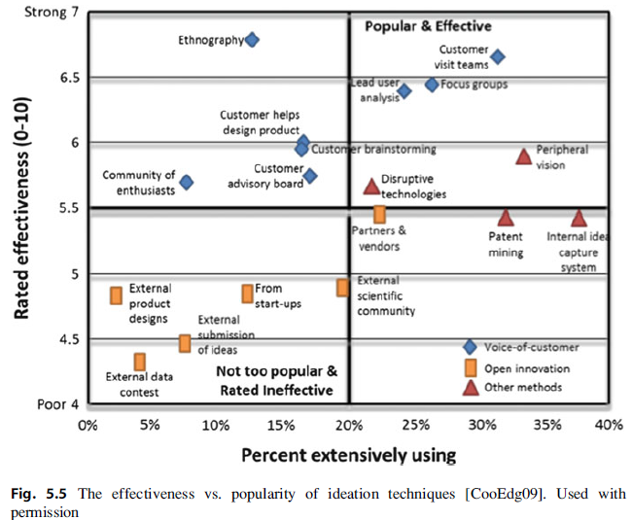
Ideation techniques (Cooper & Edgett)

Slide 24

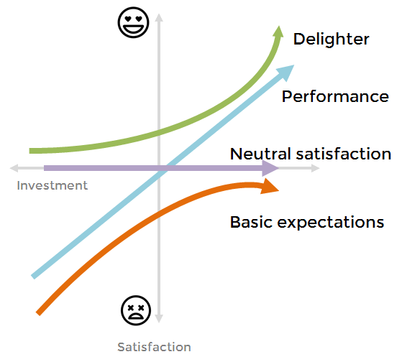
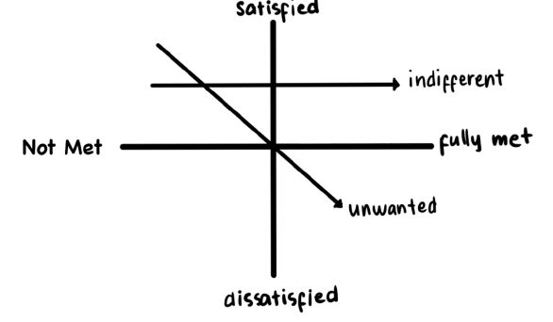
The Kano Model
Source: www.medium.com

Slide 25
Getting the product strategy right!
Viable
Feasible
Desirable

Slide 26
Getting the product strategy right!
Big
Rare
Frequent
Small

Slide 27
Getting the product strategy right!
High Price
Low Touch
High Touch
Low Price

Slide 28
Exercise 3a: Product Strategy Grid
Customer Beneﬁt | Taxis | Car Services | Uber
Must Haves
Take me where I want to go | Y | Y | Y
Performance beneﬁts
Let me quickly get a ride (faster) | Med | Low | High
Save me money (cheaper) | Med | Low | Med
Give me a nice experience (nicer) | Low | High | Med
Make me feel safe (safer) | Low | High | High
Delighters
I can book without having to call | N | N | Y
I can see where the car is | N | N | Y

Slide 29
Exercise 3b: Evaluate your product’s problem space
Problem Size vs Frequency
Big + Frequent | Small + Frequent
Big + Rare | Small + Rare
II. Price vs Cost
High Price + Low Touch | High Price + High Touch
Low Price + Low Touch | Low Price + High Touch

Slide 30
Exercise 3a: Product Strategy Grid
Customer Beneﬁt
Must Haves
Performance beneﬁts
Delighters

Slide 31
Exercise 3b: Evaluate your product’s problem space
Problem Size vs Frequency
Big + Frequent | Small + Frequent
Big + Rare | Small + Rare
II. Price vs Cost
High Price + Low Touch | High Price + High Touch
Low Price + Low Touch | Low Price + High Touch

Slide 32
Thank You!

